Slide 1

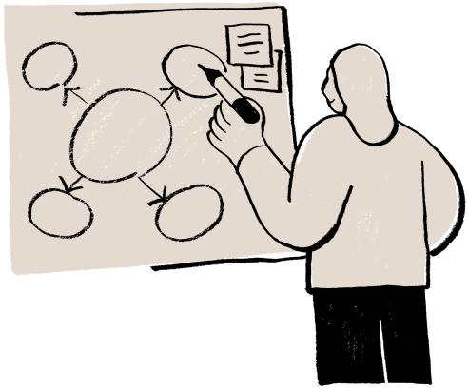
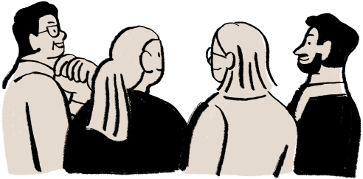
Nicholas Geremia, MSEd. | Rutgers Health
MANAGING UP
MSACROA 2025

Slide 2
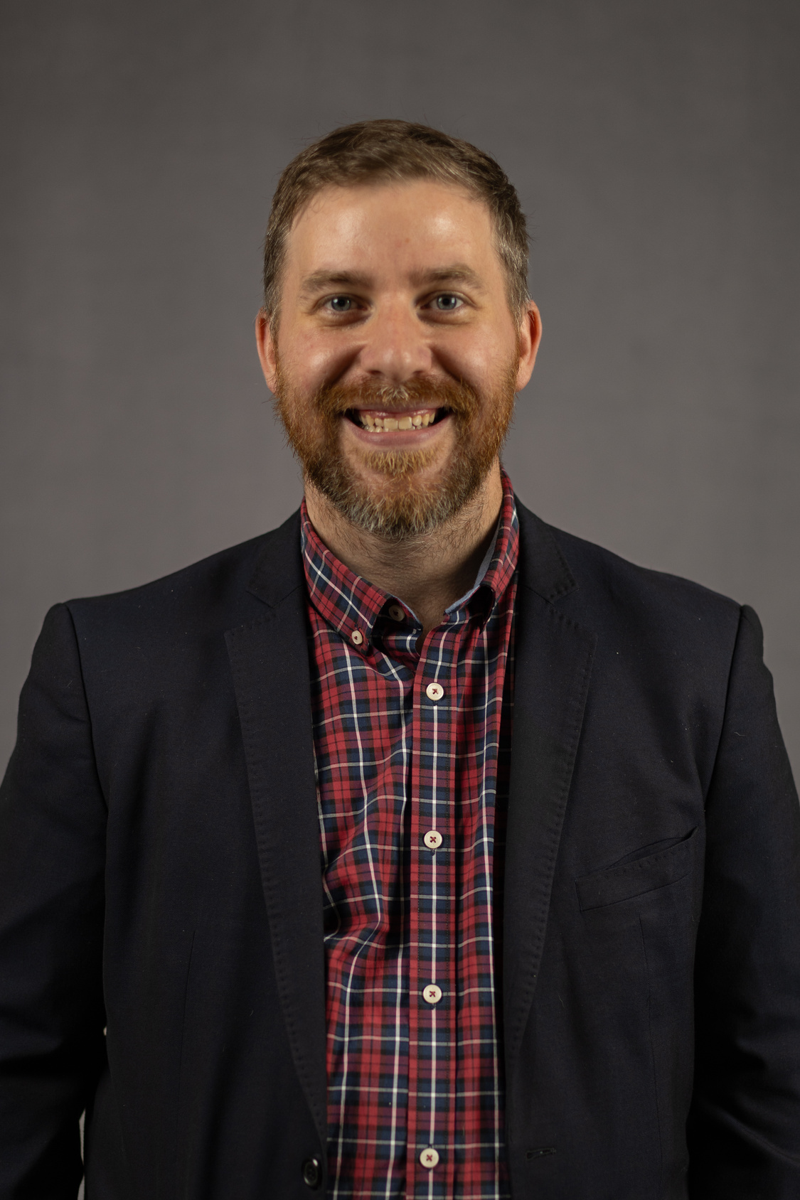
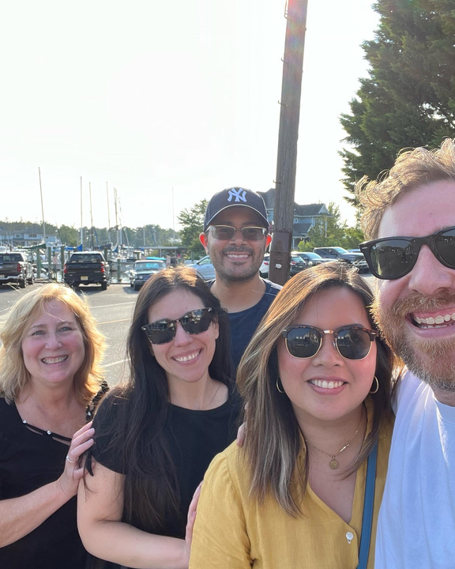

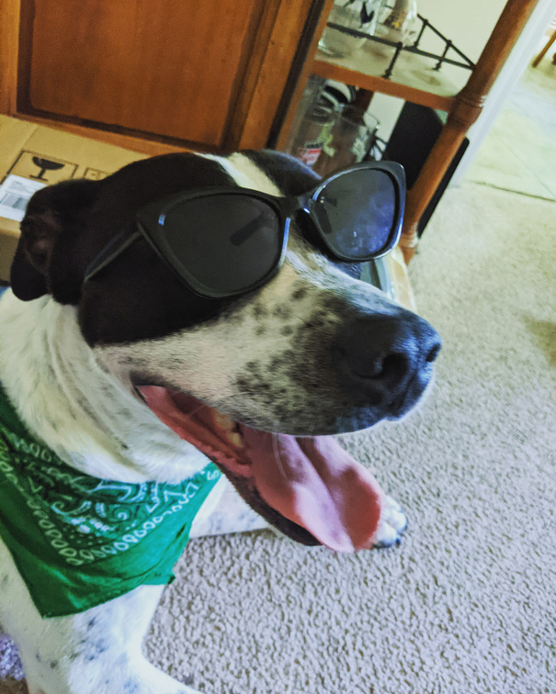



Nicholas Geremia, MSED.
Program Director, Student Affairs - Rutgers Health
10+ Years of experience in start-ups, non-profits, and higher education leadership roles centered on College Student Success
Currently researching the applicability of Succession Planning practices to support professional and career development among ‘non-academic’ staff in higher education

Slide 3

ONE MIC
One person speaking at a time!

Slide 4
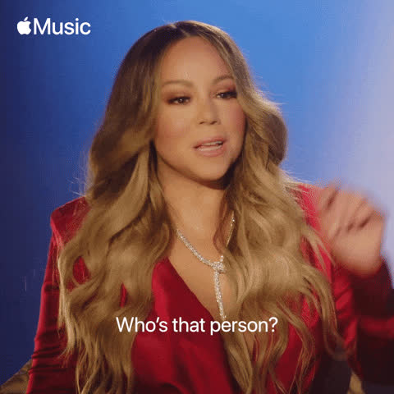
“MAKE YOURSELF KNOWN!”

Slide 5
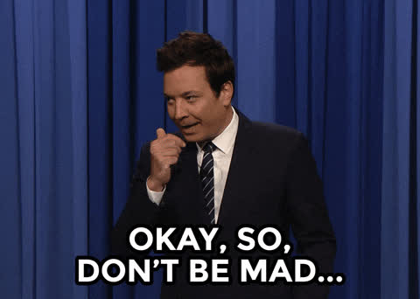
ASSUME THE BEST OF THE PRESENTER
AND YOUR PEERS

Slide 6

DON’T BE DISRESPECTFUL

Slide 7
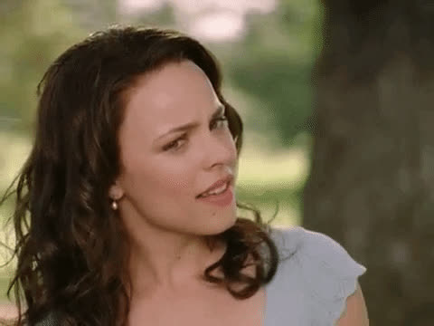

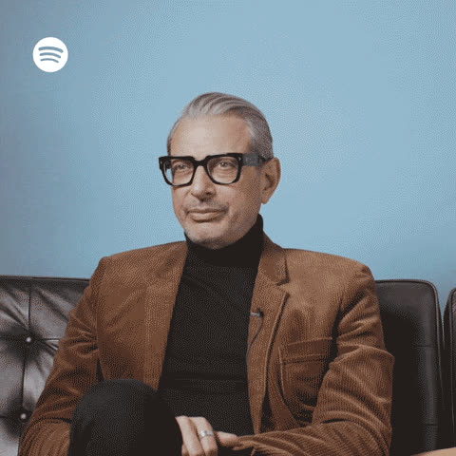




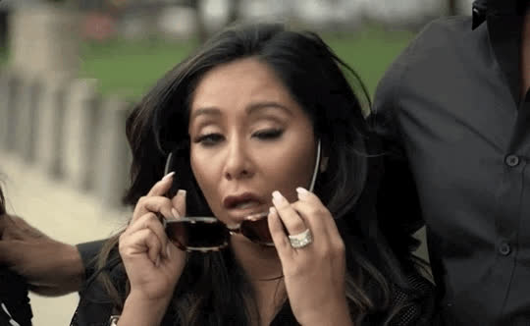

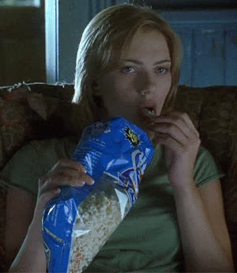



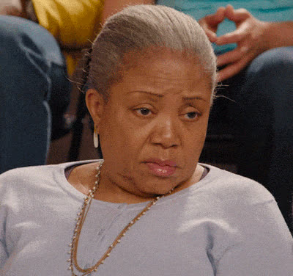

Notes:
fix-your-face slide

Slide 8
TURN & TALK
Think of a time when you a really productive relationship with a supervisor.
What made that relationship work well?

Slide 9
WHAT IS MANAGING UP?
What comes to mind when you think of ‘managing up?’

Slide 10
MANAGING UP
“The process of consciously working with your superior to obtain the best possible results for you, your boss, and the organization.”
Gabarro & Kotter, 2005

Slide 11
MANAGING UP
“The process of consciously working with your superior to obtain the best possible results for you, your boss, and the organization.”
Gabarro & Kotter, 2005

Slide 12



HIGHER ED
Complex Reporting Structures
Shared Governance Models
Resource Constraints
Competing Priorities
Faculty-Admin Tensions

Slide 13
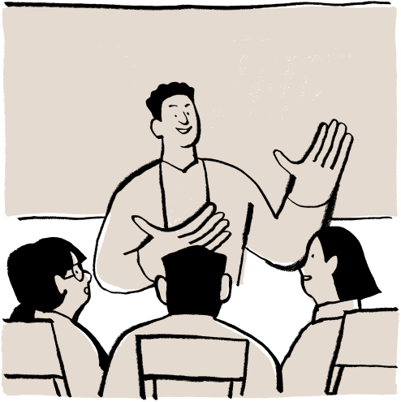
Know Their Drivers
Understanding institutional metrics and supervisor priorities
Bringing Solutions
3-Option Rule
Understand Communication Style
Style Adaptation
Proactive Communication
Documentation and Early Warning Systems
Align with Institutional Priorities
Framing requests around organizational benefits & goals
TODAY’S STRATEGIES

Slide 14
KNOW THEIR DRIVERS
Notes:
"What do you think your supervisor is measured on? Think about their performance reviews, what keeps them up at night, what they talk about most in meetings."
GUIDING QUESTIONS FOR DISCUSSION:
- How might knowing these drivers change how you communicate?
- What opportunities do you see for alignment?

Slide 15

What do you believe your supervisor is measured on?
Student Satisfaction
Faculty & Staff Satisfaction
Enrollment/Retention
Funding Goals
Accreditation Requirements
Compliance
Budget Constraints
KNOW THEIR DRIVERS
Notes:
"What do you think your supervisor is measured on? Think about their performance reviews, what keeps them up at night, what they talk about most in meetings."
GUIDING QUESTIONS FOR DISCUSSION:
- How might knowing these drivers change how you communicate?
- What opportunities do you see for alignment?

Slide 16
MANAGING UP
What are the top three issues your supervisor cares most about this semester?

Slide 17
BRINGING SOLUTIONS
(not just problems)
Notes:
"What do you think your supervisor is measured on? Think about their performance reviews, what keeps them up at night, what they talk about most in meetings."
GUIDING QUESTIONS FOR DISCUSSION:
- How might knowing these drivers change how you communicate?
- What opportunities do you see for alignment?

Slide 18

1.Here’s the problem
2.Here are 2-3 potential solutions I’ve considered
3.Here’s my recommendation and why
4.What are your thoughts?
THE 3-OPTION RULE

Slide 19
TURN & TALK
Think of a current challenge you are facing.
Turn to a partner and practice presenting it using the 3-option rule.

Slide 20

SHARE OUT
WHAT DID YOU LEARN FROM YOUR PARTNER OR GROUP?

Slide 21
KNOW THEIR STYLE

Slide 22
APPROACHES
COMMUNICATION STYLE | POTENTIAL MANAGER CHARACTERISTICS | SUGGESTED STRATEGIES TO ADAPT
Direct | Focused on the bottom-line, values quick answers, time-conscious | Lead with conclusions or potentials solutions; Be concise and clear
Collaborative | Values input and discussion, seeks out varying viewpoints | Present specific options; Ask for feedback
Detail-Oriented | Requires comprehensive information & detail | Be thorough; Provide background data; Anticipate questions
Big Picture | Focuses on strategy and outcomes | Connect to institutional or area goals

Slide 23
MANAGING UP
Which communication style best describes your current supervisor (direct, collaborative, detail-oriented, big-picture)?
How could you adapt?

Slide 24
COMMUNICATE
PROACTIVELY
Notes:
"What do you think your supervisor is measured on? Think about their performance reviews, what keeps them up at night, what they talk about most in meetings."
GUIDING QUESTIONS FOR DISCUSSION:
- How might knowing these drivers change how you communicate?
- What opportunities do you see for alignment?

Slide 25
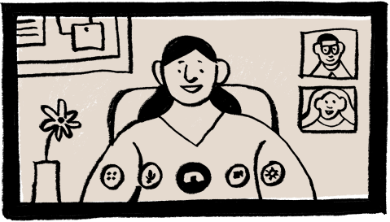
PROACTIVE COMMUNICATION
Regular Check-Ins / Briefs
Schedule brief bi/weekly updates with your manager

Slide 26

PROACTIVE COMMUNICATION
Early Warning System
Have a plan in place for flagging potential issues before they become crises

Slide 27

PROACTIVE COMMUNICATION
Documentation
“Double-click” on ambiguous information to confirm comprehension
Summarize important conversations as a follow-up email

Slide 28
PROACTIVE COMMUNICATION
Expectation Setting
Confirm understanding of the priorities and deadlines
Notes:
Don’t dodge the grunt work, yet protect your schedule.
“I can do that. What would you like me to give up for it?” The key to making that argument is that you be perceived as already fully booked.

Slide 29
BEING PROACTIVE
Status Updates
Problem Alerts
Resource Requests & Justifications
Meeting Preparation & Recap

Slide 30
BEING PROACTIVE
What would proactive communication look like in your current role?

Slide 31
ALIGN WITH
THE INSTITUTION
Notes:
"What do you think your supervisor is measured on? Think about their performance reviews, what keeps them up at night, what they talk about most in meetings."

Slide 32
MANAGING UP
Think of a recent request
you’ve made
-or-
an upcoming request you would
like to make.
Notes:
GUIDING QUESTIONS FOR DISCUSSION:
- How might knowing these drivers change how you communicate?
- What opportunities do you see for alignment?

Slide 33
TURN & TALK
Work with a partner to reframe your request in terms of institutional benefit.
Each person gets 2-3 minutes to workshop.

Slide 34
SHARE OUT
WHAT DID YOU LEARN FROM YOUR PARTNER OR GROUP?

Slide 35
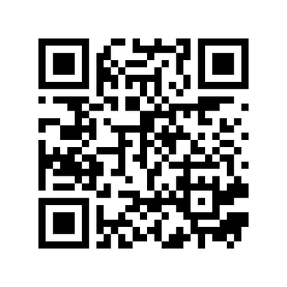
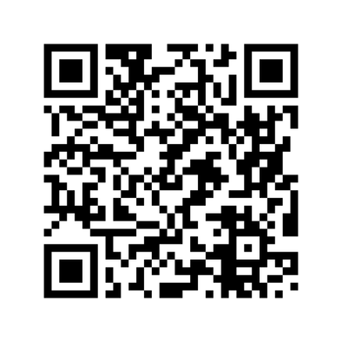

ADDITIONAL RESOURCES
Harvard Business
Review
The Chronicle
of Higher Education

Slide 36
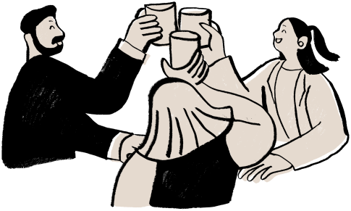
CHEERS!
THANK YOU FOR YOUR ATTENTION!
Get in touch:
Nicholas Geremia, MSEd.
Rutgers Health
Nick.Geremia@rutgers.edu

Slide 37
COMPLETE THE SURVEY!
If you learned something, please consider a
good survey rating
- but -
If you learned something and had fun,
please consider a great survey rating!

