Slide 1
Theres No Place like home: Cultivating a comfortable Family Climate in the Workplace
Presenter: Deborah Palicia, Ph.D., Registrar- Berkeley College

Slide 2
Welcome!
How is everyone Feeling this This MOrning?
Let’s take a minute to really think about this question. Let’s share a word or two that describes how you are feeling.

Slide 3
Activity
Type in the chat or raise your hand.
Write 1or 2 interesting things about yourself on a piece of paper.
Find out as many things about other attendees in the allotted time.
Share what you discovered.

Slide 4
Now
How is everyone Feeling?
Do you feel different after the activity?
Let’s share a word or two that describes how you are feeling by typing in the Chat or raising your hand.

Slide 5

The power of communication

Slide 6


Verbal and Non-verbal

Slide 7
Verbal and Non-verbal
Facial Expressions
Gestures
Posture
Personal Space
Scents
Touch
Appearance
Talking in person
Talking on the phone
Participating in Zoom
Public speaking
Asking questions
Singing

Slide 8
The environment and atmosphere
The environment can influence behavior and atmosphere.
Does it matter what and who are around you each day?
Do positive and happy situations/people make you feel better?
Does the same old day-in-and-day-out make you feel comfortable?
Does working remotely make you feel isolated, less connected and sad?
Is change a negative or a positive experience for you?
Does your persona change when your supervisor is around?

Slide 9
building a Comfortable family climate

Slide 10
To Do List
Know your team and build around them.
Trust your team.
Be present and engage in meaningful dialogue.
Lead by example.
Appreciate them as human beings and not just employees.
Be honest, transparent and listen to ideas.

Slide 11
Remember
Coming together is a beginning. Keeping together is progress. Working together is success.
Henry Ford (American Industrialist and Business Magnate)

Slide 12
The little and not so little things that matter
Real life actions on a budget

Slide 13
Photo Contest
Select a topic
Create slideshow
Share with team
Vote
Win a prize

Slide 14

Happy
Birthday

Slide 15
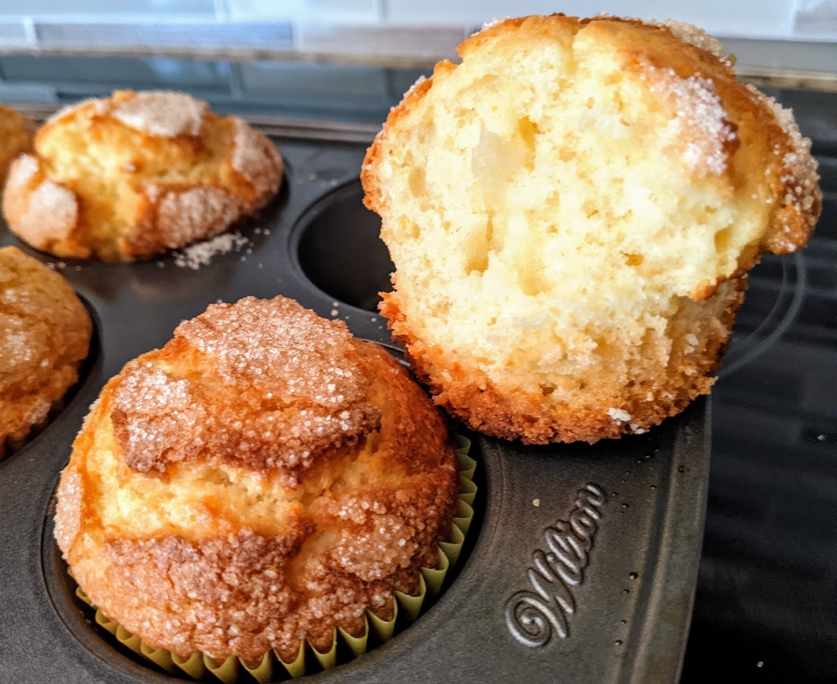
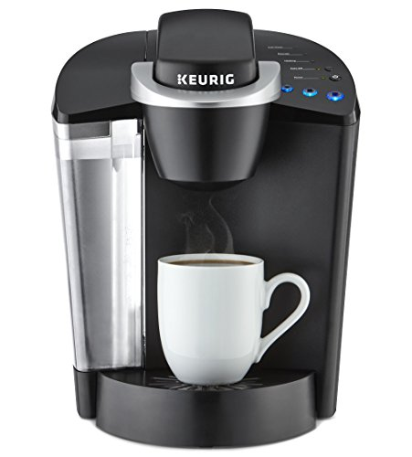
Break Time
This Photo by Unknown Author is licensed under CC BY-NC-ND

Slide 16

Events and excursions

Slide 17
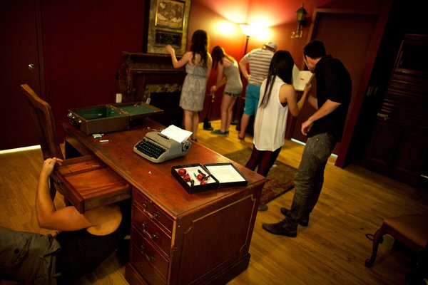
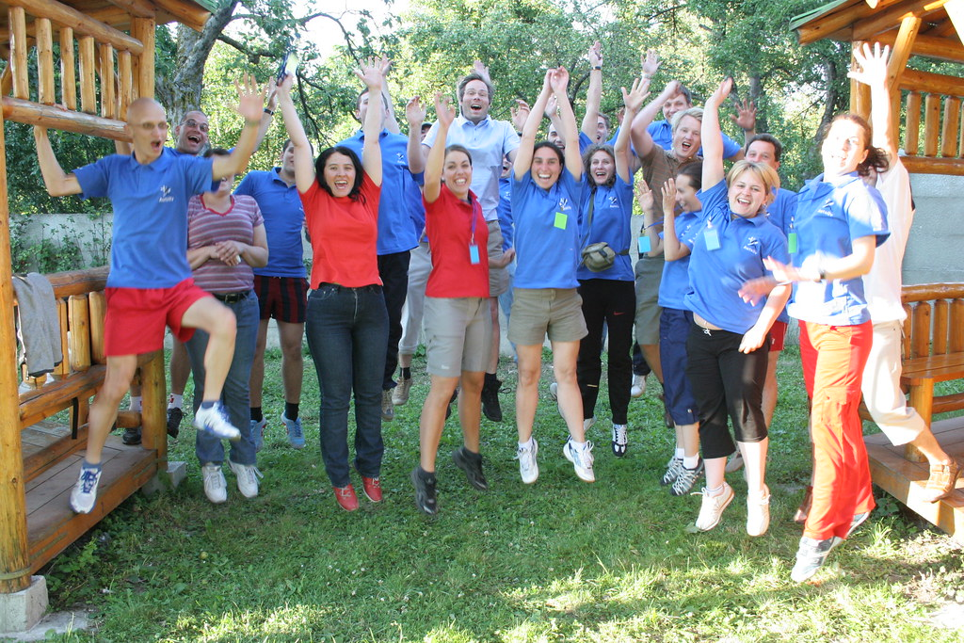
Team Building activities
Escape Rooms
Coastal Sports
This Photo by Unknown Author is licensed under CC BY-SA-NC
This Photo by Unknown Author is licensed under CC BY-NC

Slide 18

Create a Weekly NewsLetter
Registrar Town Crier

Slide 19
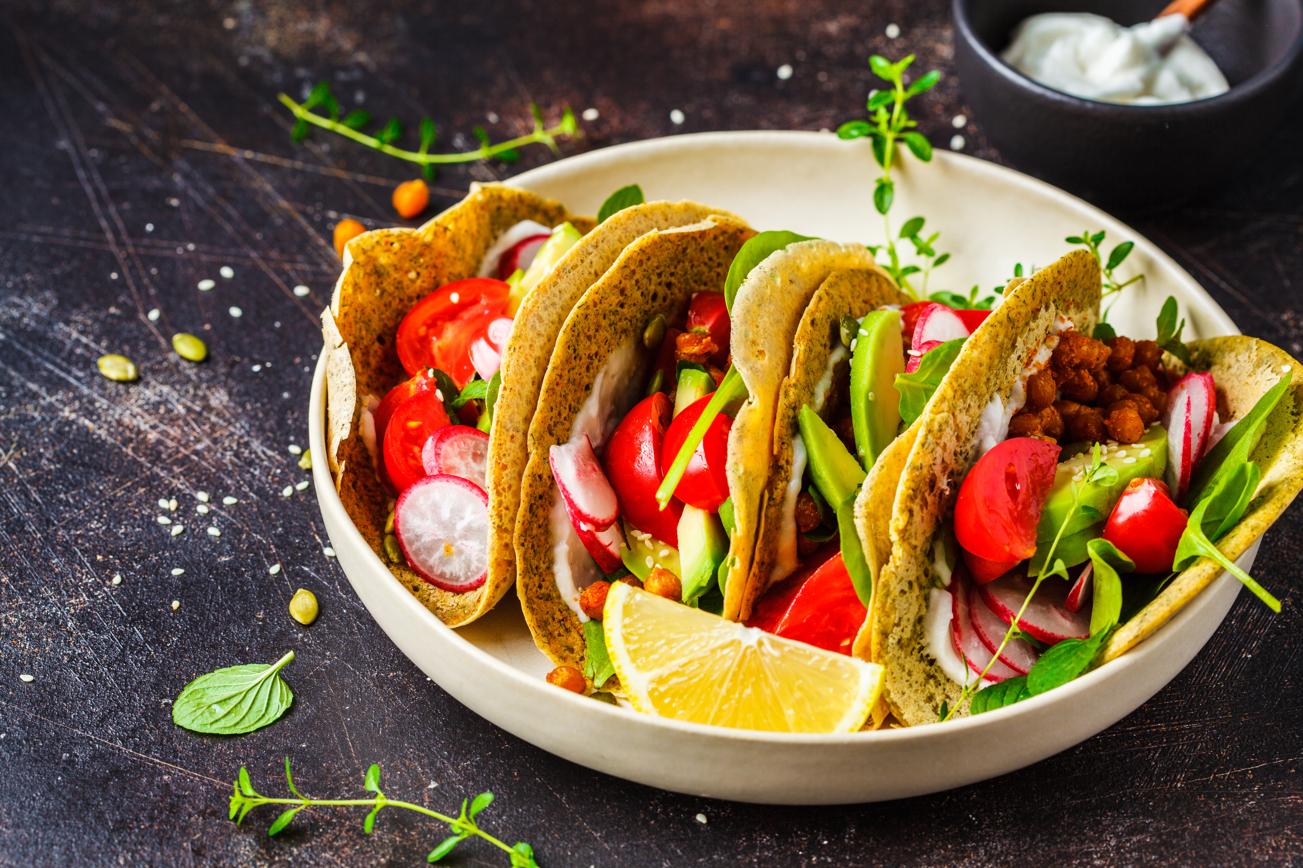
Taco Monday, Wednesday, Thursday or Friday; Never on a Tuesday

Slide 20
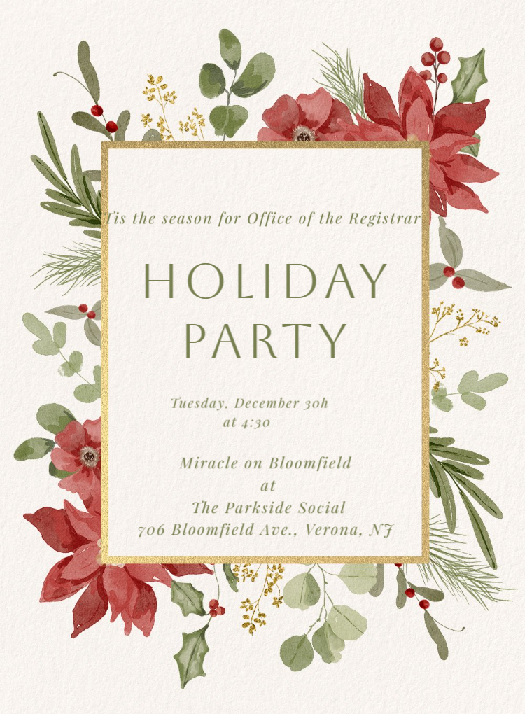
Holiday Party Time
Send an Evite

Slide 21

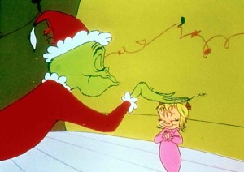
Holiday Themed locations
Miracle on Bloomfield at Park Side Social 2025
The Grinch Grotto 2024
This Photo by Unknown Author is licensed under CC BY-NC-ND

Slide 22
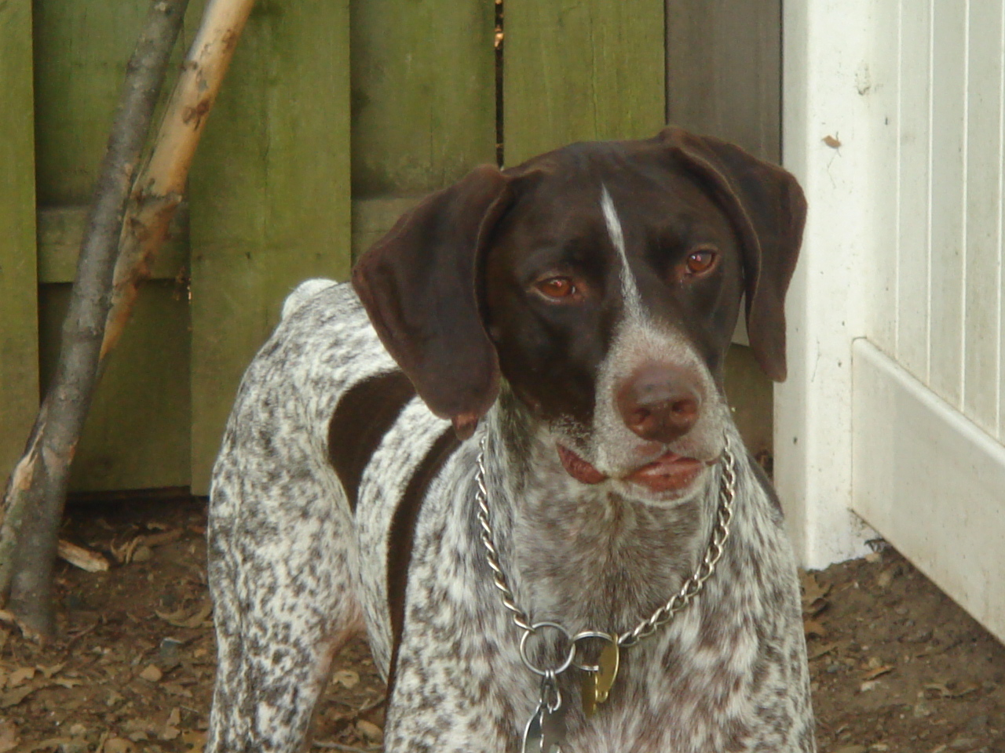
Honor Wall for those who patiently wait for our arrival home each day

Slide 23
Let’s take a few minutes to share what you are doing to Create a thriving family atmosphere in Your Office

Slide 24
Remember
There’s no magic formula for great company culture. The key is just to treat your staff how you would like to be treated.
Richard Branson (British Business Magnate)

Slide 25

Q & A Time
This Photo by Unknown Author is licensed under CC BY-NC

Slide 26
Thank you for attending!
Please be sure to fill out the Session Feedback Form before your next session.

Slide 27
And the Lucky Winner of the Amazon Gift Card is……

