Slide 1

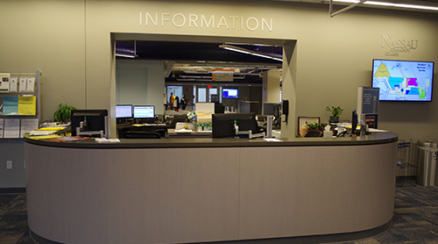
Student-Centered Service
ELEVATING EVERYDAY SERVICE - Raising the bar in the Registrar's Office
A transformational approach to customer service

Slide 2

Student-Centered Service: Raising the bar in the ADMISSIONS & Registrar's Office
Wednesday, March 25, 2026
10:00-11:30 A.M
Description: Providing exceptional transformational service in the Admissions & Registrar's Offices goes beyond answering questions it's about creating a welcoming, solution-oriented environment where students feel heard, supported, and respected. This interactive session explores practical strategies for delivering high-impact customer service, especially during high-pressure periods like registration or graduation clearance. Attendees will be introduced to a series of scenarios to practice active listening, de-escalation techniques, and handling difficult conversations with empathy.
Speaker
Chester Barkan, Nassau Community College, Registrar/Director of Special Programs
Past President, New Jersey, New York, Association of Collegiate Registrars and Admissions Officers

Slide 3
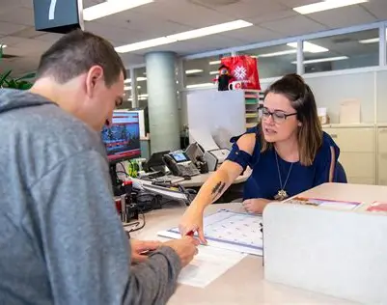
Session Objectives
In this session, participants will explore what it means to serve students with empathy and effectiveness. They will practice real-world strategies for managing difficult interactions and learn how to become better listeners.
Understand key elements of student-centered service
Practice active listening and de-escalation techniques
Develop confidence in handling difficult student interactions
Recognize that students may be navigating complex personal and academic challenges.
Communicate policies clearly, without jargon, and offer context when necessary.
Notes:
In this session, participants will explore what it means to serve students with empathy and effectiveness. They will practice real-world strategies for managing difficult interactions and learn how to become better listeners.

Slide 4
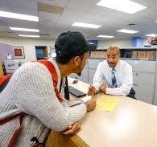
What is Student-Centered Service?
Empathy, respect, and clarity at the core
Viewing each interaction as an opportunity to support student success
Adapting responses to meet individual needs. Each student is an individual and for them the encounter with the Registrar or Admissions may be the first time.
Reflect on what the student says to validate their concerns.
Avoid assumptions — gather the full story before responding.
Student-centered service means placing the student's needs and experience at the forefront of every interaction. This involves more than policy—it’s about kindness, flexibility, and building trust.
Notes:
Student-centered service means placing the student's needs and experience at the forefront of every interaction. This involves more than policy—it’s about kindness, flexibility, and building trust.

Slide 5
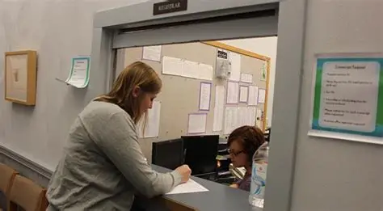
Student-Centered Service Overview
Student-centered service means seeing each student as an individual, not a transaction.
Focuses on empathy, respect, clarity, and support.
Adapt communication to meet students’ emotional and informational needs.
Feedback Example: 'You validated the student’s concern before explaining the next step—excellent emotional awareness.'

Slide 6
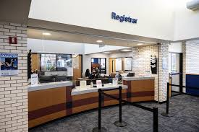
Active Listening in Action
Maintain eye contact and stay present throughout the interaction.
Paraphrase to confirm understanding: 'So what I’m hearing is…'
Ask open-ended questions to uncover the full issue.
Feedback Example: 'Your active listening defused tension and built trust with the student.'

Slide 7
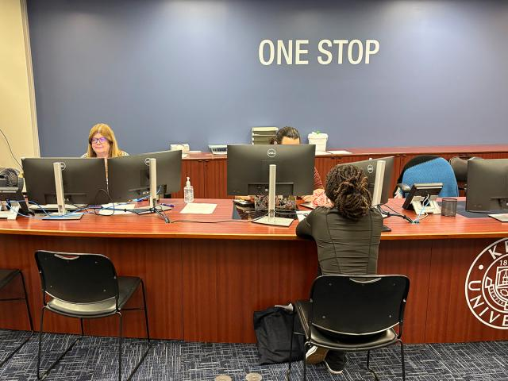
Feedback and Reflection
Encourage peer-to-peer feedback to promote service growth.
Recognize moments of empathy and patience in team debriefs.
Example: 'You kept the student calm while resolving the issue—your tone made all the difference.'
Collect and share positive student comments to motivate the team.
Now It Is Time for some real-world cases – I will set up the situation, and then we will open it up for discussion. Based on each situation, share how you would respond with the best possible responses and suggestions.

Slide 8
1. Scenario: Missing Transcript for Admissions Application
Situation
A student believes they sent their official high school transcript weeks ago, but Admissions has not received it. The student is anxious as the application deadline approaches.
Script
Student: I mailed my transcript almost a month ago, and your office keeps emailing me that it's missing. What’s going on? I don’t want to lose my spot!
Staff: Thank you for letting me know—let’s check your file together and get this resolved. Can I have your name and student ID?
(Staff checks the student record.)
Staff: I see the transcript hasn’t arrived yet. Don’t worry—here are a few steps we can take right away.
YOUR TURN – HOW WOULD YOU RESPOND

Slide 9
1. Scenario: Missing Transcript for Admissions Application
Best-Practice Response
Acknowledge the stress: “I understand this can be frustrating, especially with deadlines coming up.”
Investigate the account before offering solutions.
Offer immediate options:
  Email from school: “If your high school can send it electronically, that usually arrives fastest.”
  Temporary extension: “I can note your file so admissions knows you’re actively resolving this.”
  Document upload (if allowed): “If you have an unofficial copy, you can upload it to help us start the review.”
Positive Service Outcome
Student leaves feeling supported, knows their next steps, and trusts the office is working with—not against—them.

Slide 10
2. Scenario: Student Is Dropped from Classes for Non-Payment
Situation
A parent and student approach the Registrar’s Office upset that the student’s schedule was deleted for non-payment.
Script
Parent: We didn’t even know the bill was due! Why were the classes dropped?
Staff: I’m really sorry this happened—it’s stressful to lose classes. Let’s pull up the student account and see what options we have for re-registration today.
YOUR TURN – HOW WOULD YOU RESPOND

Slide 11
2. Scenario: Student Is Dropped from Classes for Non-Payment
Best-Practice Response
Validate emotion: “This happens to many families; we’re here to help you get back on track.”
Avoid blame; focus on solutions.
Offer practical next steps:
  Review bill due dates and communication timeline.
  Assist in immediate re-registration if seats remain.
  Escort or refer to Financial Aid to discuss grants, payment plans, or missing documents.
  Explain how to set up payment reminders or check the student portal.
Positive Service Outcome
Family feels the institution cares about helping them reenroll and avoid future issues.

Slide 12
3. Scenario: Residency & Tuition Classification Problem
Situation
A student believes they should be charged in-county tuition but was billed out-of-county.
Script
Student: Why am I being charged out-of-county tuition? I’ve lived here all my life.
Staff: Let’s look at your residency documentation together. Sometimes a missing piece of paperwork causes this, and we can fix it quickly.
YOUR TURN – HOW WOULD YOU RESPOND

Slide 13
3. Scenario: Residency & Tuition Classification Problem
Best-Practice Response
Clarify residency rules in simple terms, avoiding jargon.
Ask checking questions:
  “Have you submitted your Certificate of Residence?”
  “Has your address changed recently?”
Offer guidance:
  Provide the correct forms.
  Explain county deadlines.
  Help the student complete forms on the spot when possible.
Positive Service Outcome
Student understands the process clearly, feels respected, and leaves knowing exactly what to submit.

Slide 14
4. Scenario: Student Needs Verification for Insurance or Employment
Situation
A student urgently needs enrollment verification for a job, landlord, or insurance but the system shows them as part-time and they insist they are full-time.
Script
Student: I need proof I’m full-time today—my insurance depends on it!
Staff: Absolutely, let’s review your course load together to make sure everything is accurate.
YOUR TURN – HOW WOULD YOU RESPOND

Slide 15
4. Scenario: Student Needs Verification for Insurance or Employment
Best-Practice Response
Check credit counts and registration status.
If the student is below full-time:
  Explain the credit threshold clearly.
  Explore options such as adding a late-start class.
If the system is incorrect:
  Escalate to Registrar supervisor promptly.
  Provide a pending verification letter if office policy allows.
Positive Service Outcome
Student feels the staff took their urgent need seriously and offered practical solutions.

Slide 16
5. Scenario: Student Cannot Register Because of a Hold
Situation
A student arrives upset because they cannot register due to an academic or financial hold.
Script
Student: I’m trying to register and it keeps saying I have a hold — this system never works!
Staff: I hear how frustrating that is. Let’s look together at which hold is stopping the registration and how we can clear it.
YOUR TURN – HOW WOULD YOU RESPOND

Slide 17
5. Scenario: Student Cannot Register Because of a Hold
Best-Practice Response
Speak calmly even if the student is angry.
Identify the hold type (advisement, immunization, bursar, judicial, financial aid).
Connect them to the correct office with warm transfer:
  “Let me call the Bursar while you’re here so we can get this moving.”
Provide printed or emailed instructions for clarity.
Positive Service Outcome
Student leaves with a sense of direction rather than confusion.

Slide 18
6. Scenario: Parent Asking About Student’s Records (FERPA Challenge)
Situation
A parent wants grades, schedule, financial status—but there is no FERPA release on file.
Script
Parent: I’m paying the bill. I need to know my child’s grades and whether he’s attending class.
Staff: I completely understand why this information is important to you. Because of federal privacy laws, I can only discuss those details with the student unless we have their written permission. What I can do is explain the process so your student can set up access for you.
YOUR TURN – HOW WOULD YOU RESPOND

Slide 19
6. Scenario: Parent Asking About Student’s Records (FERPA Challenge)
Best-Practice Response
Never reveal protected information.
Use supportive language:
  “We want to help you get the information you need in the correct way.”
Provide FERPA release instructions.
Offer general guidance about policies without referencing the specific student.
Positive Service Outcome
Parent feels respected, not stonewalled, and understands compliance is legally required—not personal.

Slide 20
7. Scenario: Student Upset About Course Being Canceled
Situation
A student arrives angry because their class was canceled and they need it to graduate.
Script
Student: You canceled my class! I need that class this semester. What am I supposed to do now?
Staff: I’m sorry this happened—cancellations are never ideal. Let’s see what alternatives we can offer so your graduation plan stays on track.
YOUR TURN – HOW WOULD YOU RESPOND

Slide 21
7. Scenario: Student Upset About Course Being Canceled
Best-Practice Response
Stay calm and supportive.
Pull the student’s degree audit or major requirements.
Offer solutions:
  Another section
  A late-start alternative
  An equivalent course
  Advisement appointment for long-term planning
If necessary, request department chair approval for substitutions.
Positive Service Outcome
Student sees that staff are advocating for them and helping protect their graduation timeline.

Slide 22
TAKEAWAYS FOR effective customer service
1. Always Acknowledge the Emotion First
Before offering any solution, staff should validate the student or parent’s frustration, stress, or confusion.
Why it matters:
People relax and become cooperative once they feel heard and understood.
Example language:
“I can see why this is stressful—let’s work through it together.”
“Thank you for bringing this to us. We’ll get this sorted.”
2. Investigate the Issue Fully Before Responding
Accurate service comes from looking at the student account, reviewing documentation, and confirming facts before giving instructions or explanations.
Why it matters:
It prevents miscommunication, shows professionalism, and ensures the student receives correct guidance.

Slide 23
TAKEAWAYS FOR effective customer service
3. Focus on Solutions, Not Blame
Students and parents appreciate when staff emphasize what can be done next, rather than dwelling on mistakes, missed deadlines, or system errors.
Best practice language:
“Here’s how we can fix this today.”
“Let’s look at your options now.”
4. Explain Policies Clearly and Without Jargon
Complicated requirements (FERPA, residency, financial holds, billing deadlines) should be explained in simple, friendly terms.
Why it matters:
Clarity reduces repeat visits and builds trust with the institution.

Slide 24
TAKEAWAYS FOR effective customer service
5. Provide Step-By-Step Guidance and Next Steps
Every customer interaction should end with:
  exactly what to do next
  where to go
  what documents are needed
  when things must be completed
  who to contact for follow-up
This prevents confusion and empowers the student.
6. Make Warm Referrals (Not Cold Transfers)
  When referring a student to another office (Financial Aid, Bursar, Advisement), staff should:
  call ahead
  walk them over if possible
  email the other office with the student cc’d
Why it matters:
Students feel supported, not bounced around.

Slide 25
TAKEAWAYS FOR effective customer service
7. Protect Student Privacy While Remaining Helpful
FERPA situations require firm boundaries but also friendly explanations.
Best practice:
“I can help explain the policy and the steps your student can take to grant permission.”
This leaves parents feeling respected and not dismissed.
8. Maintain a Calm, Positive Tone—Even When Students Are Upset
The staff member should always be the calming force in the interaction.
Staff mindset:
Do not take frustration personally.
Speak slowly and reassure the customer.
Keep your voice welcoming and patient.

Slide 26
TAKEAWAYS FOR effective customer service
9. Turn Every Problem Into an Opportunity to Educate
Whether it's billing, registration holds, or transcripts, each interaction is a chance to help a student understand how processes work.
Outcome:
Students become more self-sufficient and confident navigating the college.
10. End Every Interaction With Confirmation of Understanding
Before the student leaves the counter or hangs up the phone, ask:
“Does everything make sense?”
“Is there anything else I can check for you?”
“Would you like this written down or emailed to you?”
This reduces confusion and increases satisfaction.
11. It is also nice to have a piece of Candy available……

Slide 27
CONCLUDING THOUGHT
"Every interaction is an opportunity to build trust and create a positive impact."

